Slide 1
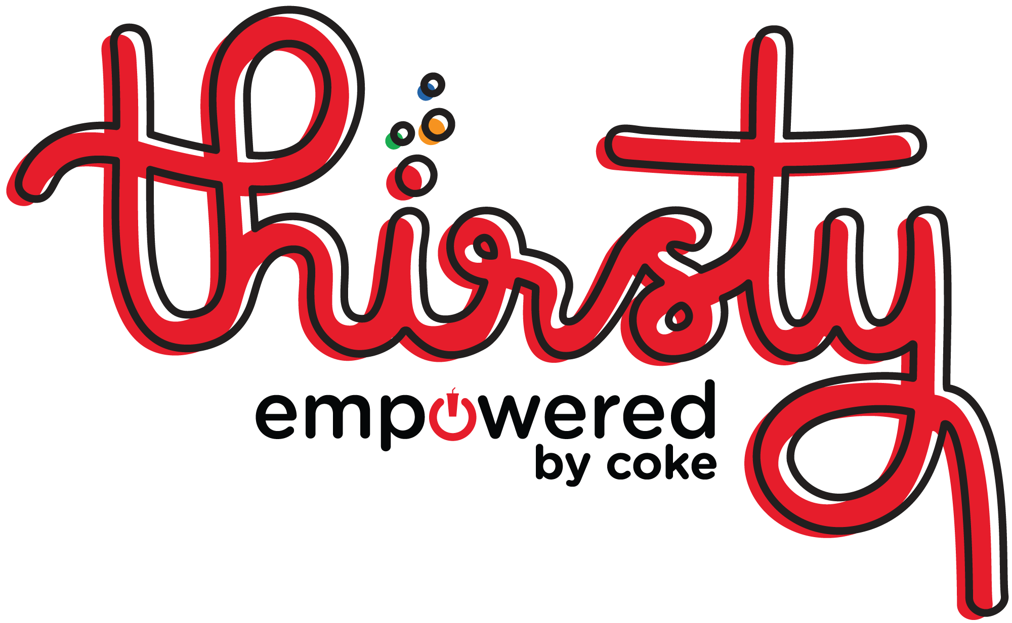
Your One-Stop Beverage System Platform
Service Technology as It Should Be
… Refreshing
Business name | 08/01/2018

Slide 2
What is Thirsty?
We understand your day is busy. The last thing you need is the hassle and headache of a beverage machine issue. That’s why we’ve developed Thirsty – a new equipment installation and mechanical service platform specifically designed to facilitate a better, more efficient and collaborative service experience for you.
Just like any Coca-Cola beverage, it’s intended to deliver more happiness with every interaction.

Slide 3
It Contains the Right Ingredients
Today: Experience the benefits of modern technology with service that’s easier and more intuitive
Future: Get access to your very own customer portal with self-serve capabilities for quick resolution

Slide 4
You Know What You’re Getting
Today: Forget the ‘20 questions’ when you call for service since we’ve got your outlet information archived in the system
Future: Enjoy increased visibility into your equipment servicing with past transactions and recent requests a click away

Slide 5
Add Your Own Flavor
Today: Choose to receive either a text or email (you pick!) for updates on a technician or work ticket
Future: Communicate with your technician using two-way texting or a chat feature to stay informed on arrival and service

Slide 6
To Make the Taste Just Right
Today: Count on one of our 6,000+ certified technicians to help troubleshoot issues over the phone
Future: Video chat live one-on-one with a technician who can deliver answers and get you up and running in no time

Slide 7
Always Feel Refreshed – 24/7/365
Thirsty makes it easier than ever to do your job and keep outlet equipment flowing with the beverages consumers crave.
But should you have any questions, our trusted team of experts is available for you whenever and however you need us. Because no one should have to enjoy Coca-Cola alone.

Slide 8
Thank You!
Anyrep Reppington
555.555.5555
email@email.com

